Slide 1

Project Title
Team Name: SuNiRa Squad
Track: Artificial Intelligence
Problem Statement: Vaccination Alert System

Slide 2

Problem Statement:
Missed or delayed vaccinations due to lost records & lack of reminders.
Manual tracking is inefficient for patients and healthcare providers.
Proposed Solution:
Smart Vaccination Card (QR-based) with digital records.
Automatic alerts & reminders for upcoming/missed doses.

Slide 3

Create
Add
User Details
Start
Admin
Data Storage
End
Scan
Update
User Details
https://drive.google.com/file/d/1EpHZ8pJJZom9d2gTMfvQZbkrhemIYgzd/view?usp=sharing

Slide 4

Simplicity: The interface uses a clean, minimal layout with clear icons and color indicators for completed, upcoming, and missed vaccines. Reducing user effort and improving interaction speed.
Accessibility: Includes multilingual support, large buttons, and high-contrast visuals for elderly and visually impaired users. The design ensures smooth access on mobile, tablet, and desktop devices.
Usability: A dashboard-based view lets users quickly check vaccination records, reminders, and QR codes. Automated prompts and alerts guide users through every step with minimal clicks.
Creative Design Choices: Features like a vaccine timeline, QR animations, and health-themed color palette (blue-green tones) make the system visually engaging and trustworthy.

Slide 5

QR-Enabled Smart Vaccination Card: Unlike traditional paper-based cards, our solution creates a portable digital identity that can be scanned and updated instantly.
Automatic Reminder System: Delivers vaccination alerts through SMS or email.
Data Analytics & Insights: Helps health departments monitor vaccination coverage and identify under-immunized populations.
Offline Accessibility: Records can be accessed offline once downloaded, ensuring usability in remote areas.

Slide 6

Feasibility: Hospitals can issue QR-based vaccination cards and use our dashboard to scan and update records. The system is low-cost, secure, and works efficiently in hospital settings.
Competitor Edge: Unlike standard reminder apps or paper records, our solution combines physical QR cards with a digital dashboard, allowing quick scanning, instant updates, and easy tracking.
Impact: Parents can be assured their child’s vaccination records are accurate. Healthcare providers can manage and verify records efficiently. Public health authorities get data from hospital.
Benefits:
Short-term: Reduces errors and missed vaccinations in hospitals. Long-term: Creates a scalable hospital-based vaccination system for improved public health monitoring.

Slide 7

Frontend: HTML, CSS
– for a clean, responsive hospital dashboard.
Backend: PHP, XAMPP
– handles QR scan processing and record updates.
Database: MySQL
– stores patient and vaccination data securely.
APIs/Integrations: QR code library
– for generating and scanning vaccination cards.

Slide 8

Clear Explanation:
A QR-based vaccination card issued by hospitals.
Dashboard for scanning and updating records in real-time.
Ensures accurate tracking, reminders, and easy verification.
Relevance:
Social Need: Prevents missed vaccinations, ensures children and adults are fully immunized.
Industry Need: Hospitals and clinics can maintain efficient, error-free records.

Slide 9


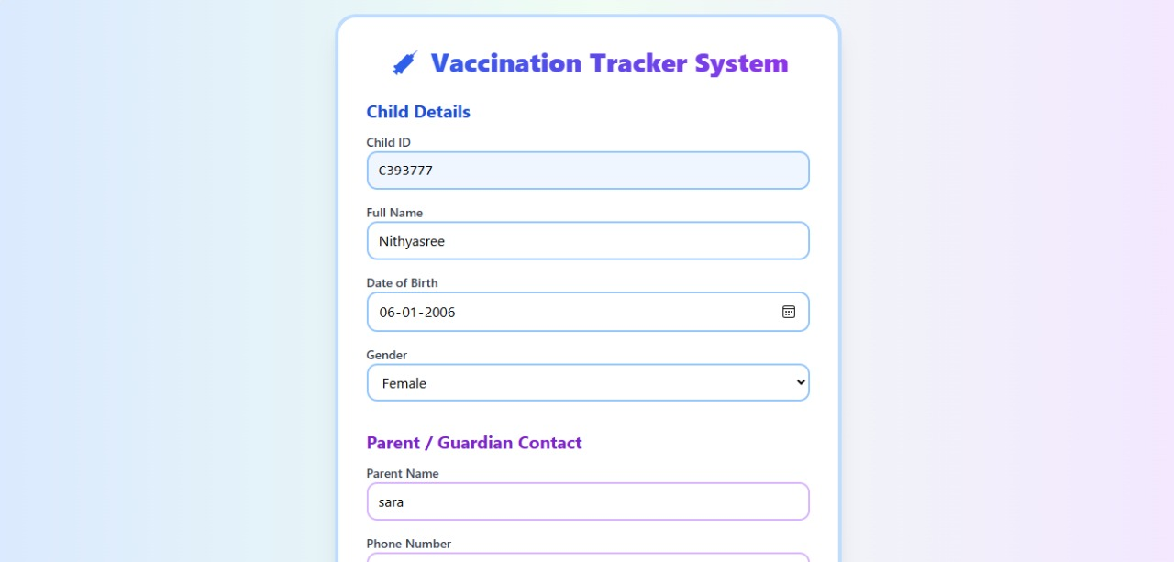
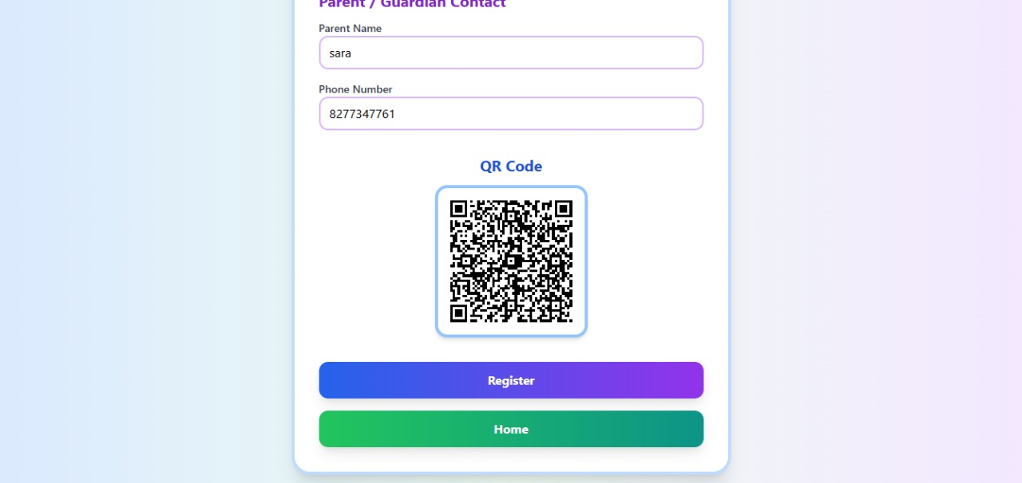
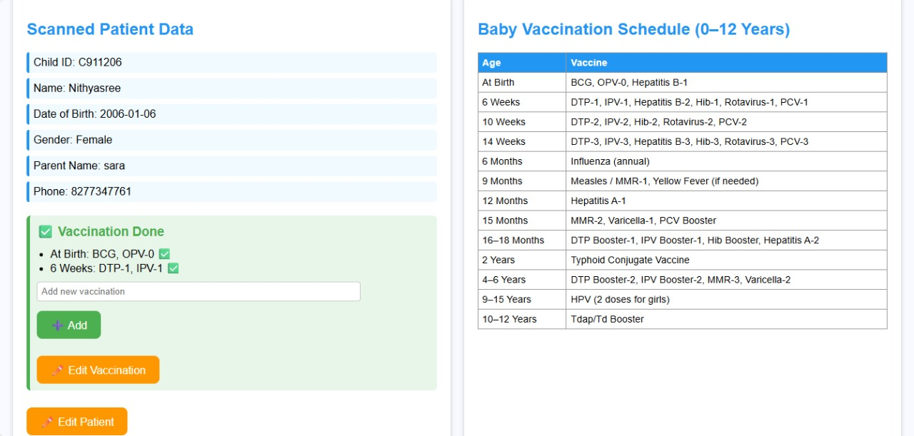
Key Features:
QR-Based Digital Smart Card – Secure, unique QR code for every individual, replacing paper vaccination cards.
Automatic Alerts & Reminders – Sends timely notifications to ensure no vaccine is missed or delayed.
Parent & Child Linking Feature – Especially for pediatric use; parents can manage and track multiple children’s vaccination schedules.
Offline Accessibility – Records can be accessed offline once downloaded, ensuring usability in remote areas.
Data Analytics & Insights – Helps health departments monitor vaccination coverage and identify under-immunized populations.

Slide 10

Research & References:
“Mobile-Based Immunization Tracking Systems for Developing Regions” – (2023)
https://www.who.int/teams/immunization-vaccines-and-biologicals/digital-solutions
“AI-Assisted Reminder Systems for Preventive Healthcare” – ACM Transactions on Computing for Healthcare (2022)
Future Roadmap:
Phase 1 – Pilot Deployment (Short-Term, 0–6 months)
Phase 2 – State-Level Expansion (Mid-Term, 6–12 months)
Phase 3 – Nationwide Integration (Long-Term, 1–2 years)
Phase 4 – Global Adaptation (Future Scope)

